Slide 1

Chapter 6
Developing an Effective Business Model
Bruce R. Barringer
R. Duane Ireland
Copyright ©2012 Pearson Education, Inc. publishing as Prentice Hall
6-<number>

Slide 2
Chapter Objectives
1 of 2
Describe a business model.
Explain business model innovation.
Discuss the importance of having a clearly articulated business model.
Discuss the concept of the value chain.
Identify a business model’s two potential fatal flaws.
Copyright ©2012 Pearson Education, Inc. publishing as Prentice Hall
6-<number>

Slide 3
Chapter Objectives
2 of 2
Identify a business model’s four major components.
Explain the meaning of the term business concept blind spot.
Define the term core competency and describe its importance.
Explain the concept of supply chain management.
Explain the concept of fulfillment and support.
Copyright ©2012 Pearson Education, Inc. publishing as Prentice Hall
6-<number>

Slide 4
What is a Business Model?
Model
  A model is a plan or diagram that’s used to make or describe something.
Business Model
  A firm’s business model is its plan or diagram for how it competes, uses its resources, structures its relationships, interfaces with customers, and creates value to sustain itself on the basis of the profits it generates.
  The term “business model” is used to include all the activities that define how a firm competes in the marketplace.
Copyright ©2012 Pearson Education, Inc. publishing as Prentice Hall
6-<number>

Slide 5
Dell’s Business Model
1 of 2
Beyond Its Own Boundaries
  It’s important to understand that a firm’s business model takes it beyond its own boundaries.
  Almost all firms partner with others to make their business models work.
  In Dell’s case, it needs the cooperation of its suppliers, customers, and many others to make its business model work.
Copyright ©2012 Pearson Education, Inc. publishing as Prentice Hall
6-<number>

Slide 6
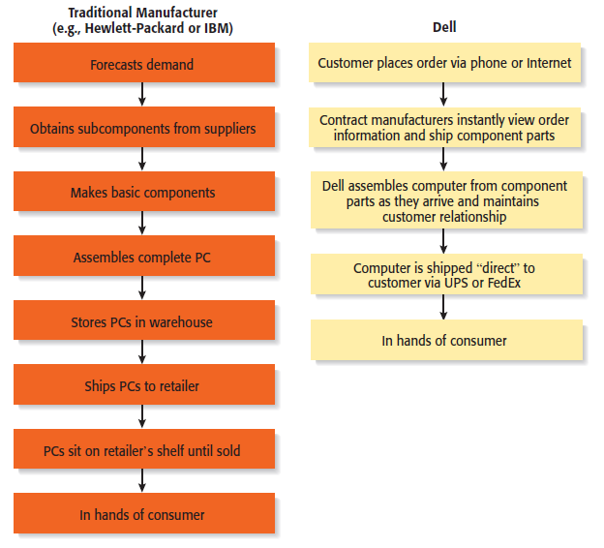
Dell’s Business Model
2 of 2
Dell’s Approach to Selling PCs versus Traditional Manufacturers
Copyright ©2012 Pearson Education, Inc. publishing as Prentice Hall
6-<number>

Slide 7
The Importance of Business Models
Having a clearly articulated business model is important because it does the following:
Serves as an ongoing extension of feasibility analysis. A business
model continually asks the question, “Does this business make
sense?”
Focuses attention on how all the elements of a business fit
together and constitute a working whole.
Describes why the network of participants needed to make a
business idea viable are willing to work together.
Articulates a company’s core logic to all stakeholders, including
the firm’s employees.
Copyright ©2012 Pearson Education, Inc. publishing as Prentice Hall
6-<number>

Slide 8
Diversity of Business Models
There is no standard business
model for an industry or for
a target market within an
industry.
However, over time, the most
successful business models
in an industry predominate.
There are always opportunities
for business model innovation.
Diversity or Variety in Business Models
Copyright ©2012 Pearson Education, Inc. publishing as Prentice Hall
6-<number>

Slide 9
How Business Models Emerge
1 of 3
The Value Chain
  The value chain is the string of activities that moves a product from the raw material stage, through manufacturing and distribution, and ultimately to the end user.
  By studying a product’s or service’s value chain, an organization can identify ways to create additional value and assess whether it has the means to do so.
  Value chain analysis is also helpful in identifying opportunities for new businesses and in understanding how business models emerge.
Copyright ©2012 Pearson Education, Inc. publishing as Prentice Hall
6-<number>

Slide 10
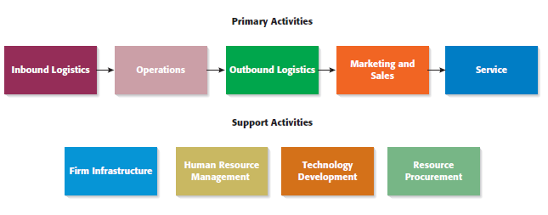
How Business Models Emerge
2 of 3
The Value Chain
Copyright ©2012 Pearson Education, Inc. publishing as Prentice Hall
6-<number>

Slide 11
How Business Models Emerge
3 of 3
The Value Chain (continued)
  Entrepreneurs look at the value chain of a product or a service to pinpoint where the value chain can be made more effective or to spot where additional “value” can be added.
  This type of analysis may focus on:
    A single primary activity such as marketing and sales.
    The interface between one stage of the value chain and another, such as the interface between operations and outgoing logistics.
    One of the support activities, such as human resource management.
Copyright ©2012 Pearson Education, Inc. publishing as Prentice Hall
6-<number>

Slide 12
Potential Fatal Flaws in Business Models
Fatal Flaws
  Two fatal flaws can render a business model untenable from the beginning:
    A complete misread of the customer
    Utterly unsound economics
Copyright ©2012 Pearson Education, Inc. publishing as Prentice Hall
6-<number>

Slide 13
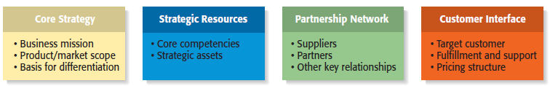
Components of a Business Model
Four Components of a Business Model
Copyright ©2012 Pearson Education, Inc. publishing as Prentice Hall
6-<number>

Slide 14
Core Strategy
1 of 3
Core Strategy
  The first component of a business model is the core strategy, which describes how a firm competes relative to its competitors.
Primary Elements of Core Strategy
  Mission statement
  Product/market scope
  Basis for differentiation
Copyright ©2012 Pearson Education, Inc. publishing as Prentice Hall
6-<number>

Slide 15
Core Strategy
2 of 3
Primary Elements of Core Strategy
A firm’s mission, or mission statement, describes why it exists and what its business model is supposed to accomplish.
Mission Statement
Product/Market Scope
A company’s product/market scope defines the products and markets on which it will concentrate.
Copyright ©2012 Pearson Education, Inc. publishing as Prentice Hall
6-<number>

Slide 16
Core Strategy
3 of 3
Primary Elements of Core Strategy
It is important that a new venture differentiate itself from its competitors in some way that is important to its customers. If a new firm’s products or services aren’t different from those of its competitors, why should anyone try them?
Basis of Differentiation
Copyright ©2012 Pearson Education, Inc. publishing as Prentice Hall
6-<number>

Slide 17
Strategic Resources
1 of 3
Strategic Resources
  A firm is not able to implement a strategy without resources, so the resources a firm has affect its business model substantially.
    For a new venture, its strategic resources may initially be limited to the competencies of its founders, the opportunity they have identified, and the unique way they plan to serve their market.
  The two most important strategic resources are:
    A firm’s core competencies
    Strategic assets
Copyright ©2012 Pearson Education, Inc. publishing as Prentice Hall
6-<number>

Slide 18
Strategic Resources
2 of 3
Primary Elements of Strategic Resources
A core competency is a resource or capability that serves as a source of a firm’s competitive advantage. Examples include Sony’s competence in miniaturization and Dell’s competence in supply chain management.
Core Competencies
Strategic assets are anything rare and valuable that a firm owns. They include plant and equipment, location, brands, patents, customer data, a highly qualified staff, and distinctive partnerships.
Strategic Assets
Copyright ©2012 Pearson Education, Inc. publishing as Prentice Hall
6-<number>

Slide 19
Strategic Resources
3 of 3
Importance of Strategic Resources
  New ventures ultimately try to combine their core competencies and strategic assets to create a sustainable competitive advantage.
  This factor is one that investors pay close attention to when evaluating a business.
  A sustainable competitive advantage is achieved by implementing a value-creating strategy that is unique and not easy to imitate.
  This type of advantage is achievable when a firm has strategic resources and the ability to use them.
Copyright ©2012 Pearson Education, Inc. publishing as Prentice Hall
6-<number>

Slide 20
Partnership Network
1 of 3
Partnership Network
  A firm’s partnership network is the third component of a business model. New ventures, in particular, typically do not have the resources to perform key roles.
  In most cases, a business does not want to do everything itself because the majority of tasks needed to build a product or deliver a service are not core to a company’s competitive advantage.
  A firm’s partnership network includes:
    Suppliers
    Other key relationships
Copyright ©2012 Pearson Education, Inc. publishing as Prentice Hall
6-<number>

Slide 21
Partnership Network
2 of 3
Primary Elements of Partnership Network
A supplier is a company that provides parts or services to another company. Intel is Dell’s primary suppler for computer chips, for example.
Suppliers
Firms partner with other companies to make their business models work. An entrepreneur’s ability to launch a firm that achieves a competitive advantage may hinge as much on the skills of the partners as on the skills within the firm itself.
Other Key Relationships
Copyright ©2012 Pearson Education, Inc. publishing as Prentice Hall
6-<number>

Slide 22
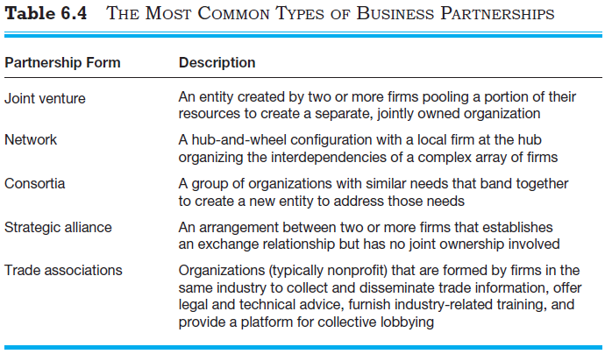
Partnership Network
3 of 3
The Most Common Types of Business Partnerships
Copyright ©2012 Pearson Education, Inc. publishing as Prentice Hall
6-<number>

Slide 23
Customer Interface
1 of 3
Customer Interface
  The way a firm interacts with its customer hinges on how it chooses to compete.
    For example, Amazon.com sells books over the Internet while Barnes & Noble sells through its traditional bookstores and online.
  The three elements of a company’s customer interface are:
    Target customer
    Fulfillment and support
    Pricing model
Copyright ©2012 Pearson Education, Inc. publishing as Prentice Hall
6-<number>

Slide 24
Customer Interface
2 of 3
Primary Elements of Customer Interface
Target Market
A firm’s target market is the limited group of individuals or businesses that it goes after or tries to appeal to.
Fulfillment and support describes the way a firm’s product or service reaches its customers. It also refers to the channels a company uses and what level of customer support it provides.
Fulfillment and Support
Copyright ©2012 Pearson Education, Inc. publishing as Prentice Hall
6-<number>

Slide 25
Customer Interface
3 of 3
Primary Elements of Customer Interface
The third element of a company’s customer interface is its pricing structure. Pricing models vary, depending on a firm’s target market and its pricing philosophy.
Pricing Structure
Copyright ©2012 Pearson Education, Inc. publishing as Prentice Hall
6-<number>

Slide 26
Recap: The Importance of Business Models
Business Models
  It is very useful for a new venture to look at itself in a holistic manner and understand that it must construct an effective “business model” to be successful.
  Everyone that does business with a firm, from its customers to its partners, does so on a voluntary basis. As a result, a firm must motivate its customers and its partners to play along.
  Close attention to each of the primary elements of a firm’s business model is essential for a new venture’s success.
Copyright ©2012 Pearson Education, Inc. publishing as Prentice Hall
6-<number>

Slide 27

All rights reserved. No part of this publication may be reproduced, stored in a retrieval system, or transmitted, in any form or by any means, electronic, mechanical, photocopying, recording, or otherwise, without the prior written permission of the publisher. Printed in the United States of America.
Copyright ©2012 Pearson Education, Inc. publishing as Prentice Hall
Copyright ©2012 Pearson Education, Inc. publishing as Prentice Hall
6-<number>

